Slide 1
3D web game presentation

Slide 2
Achievements
Movement – INC Camera following
Playing on a server
Skybox
Creation of a simple Play area

Slide 3
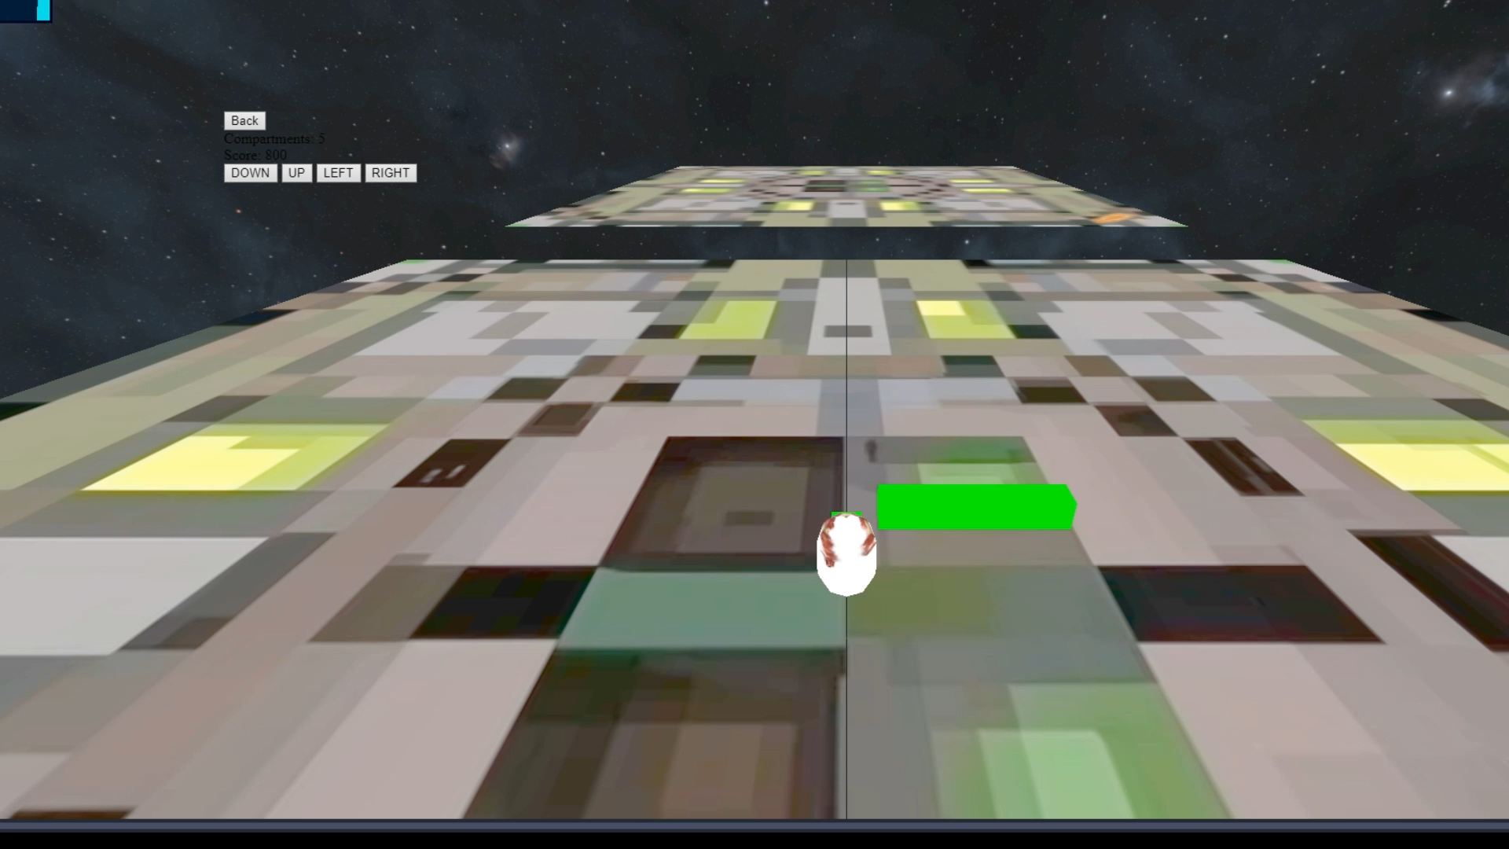
Movement – INC Camera following

Slide 4
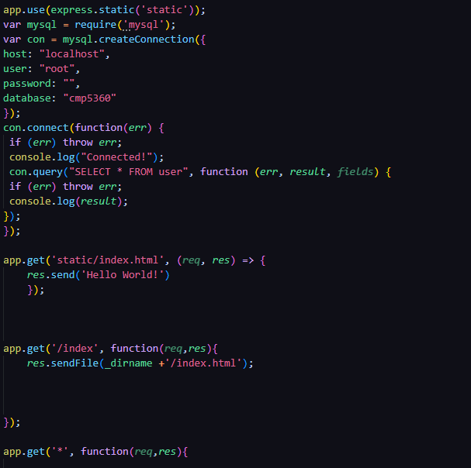
Playing on a server
Server code:
When player changes https it will direct to
404 Page

Slide 5
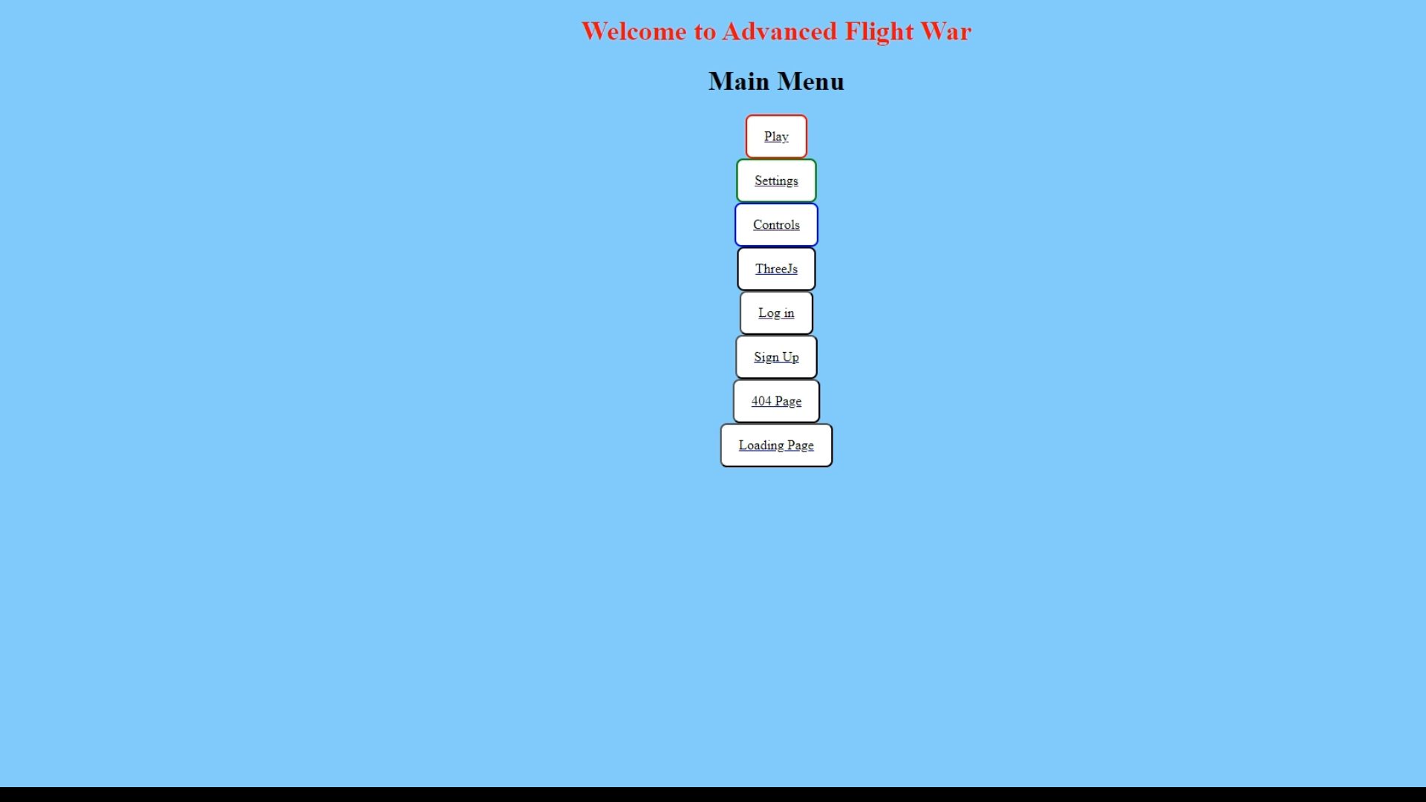
Pages

Slide 6
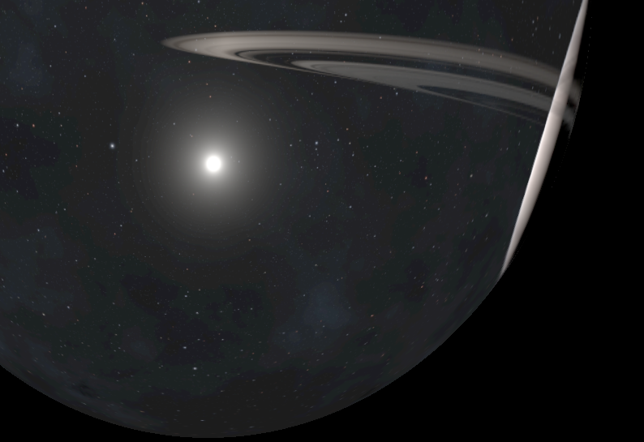
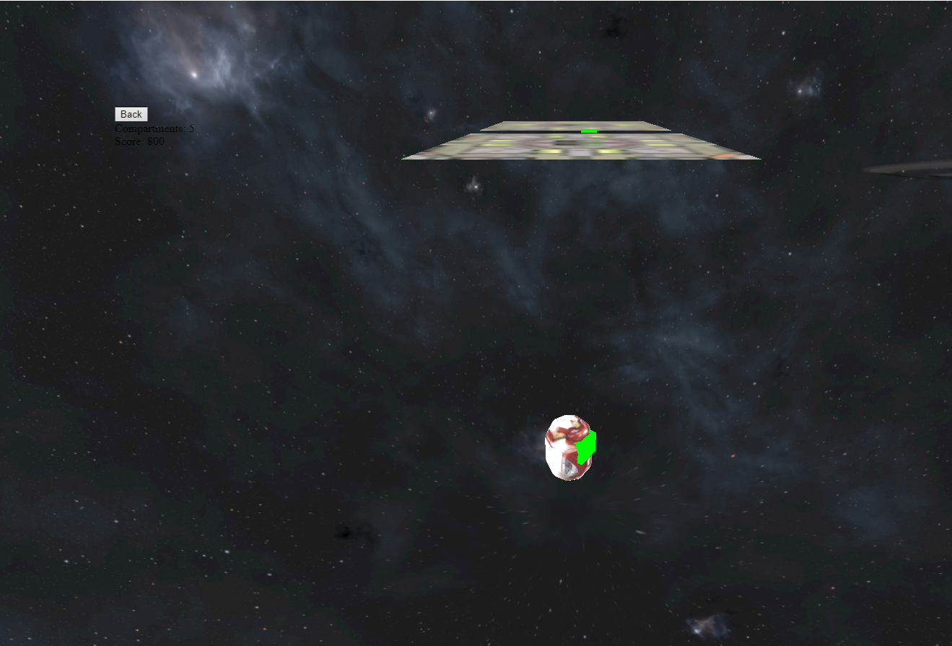
Skybox

Slide 7
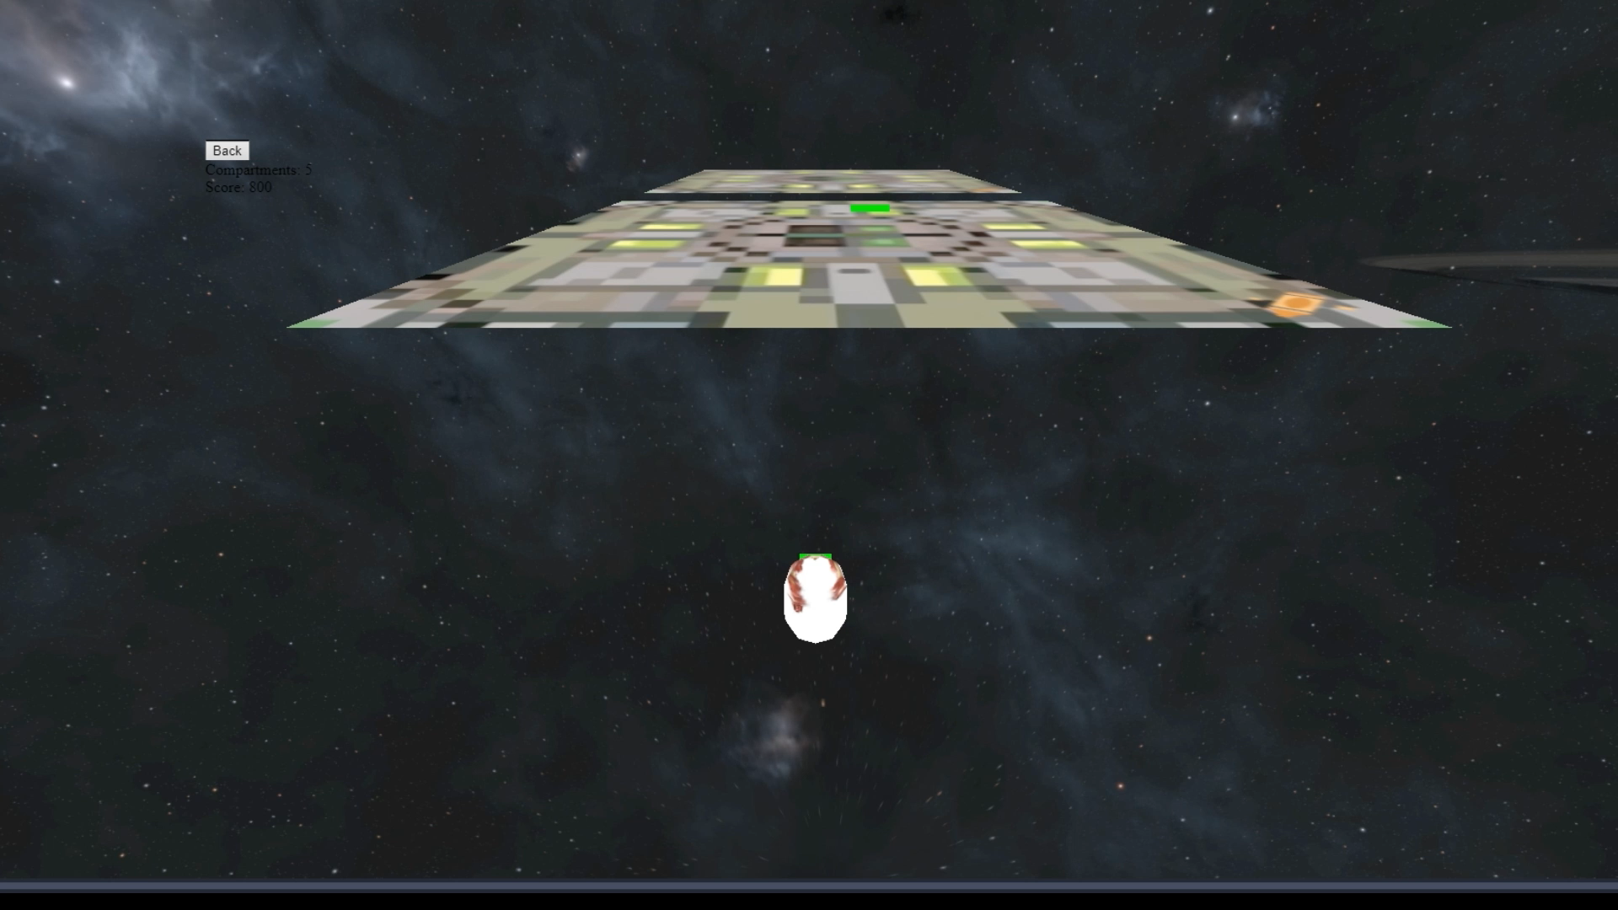
Creation of a simple Play area

Slide 8

Whats next
Implementing collisions
Change map
Add in sign up system + Log in

Slide 9

Questions

